Slide 1


BOOKS ABOUT SOMEONE ELSE
Biographies
ACEN eBooks of the Week

Slide 2





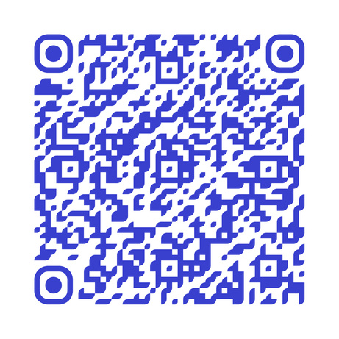
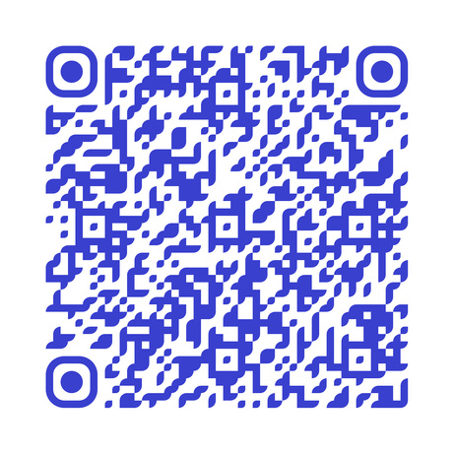
Junior Reads

Slide 3





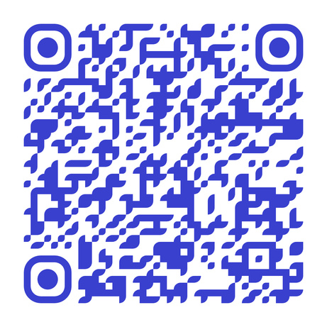
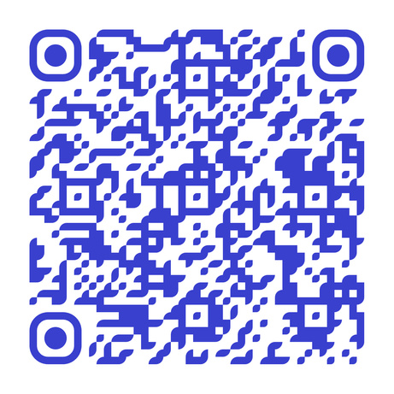
Primary Reads

